Slide 1



CREDIT RISK ANALYSIS
X
Presented by
R. Arnanda Adi Wijanarko

Slide 2


X
Experience
Created by:
R. Arnanda Adi Wijanarko
Linkedln: https://www.linkedin.com/in/r-arnanda
Github: https://github.com/ArnandaAdi
RAKAMIN ACADEMY (2023)
As the runner-up team in the competition, our successful use of the Random Forest classifier significantly improved our ability to predict potential customers, resulting in a remarkable 78% increase in conversion rate.
Project-Based Virtual Intern : Big Data Analytics Kimia Farma x Rakamin Academy (August 2023)
Analyse sales reports from the company database
Developed data marts through database creation and data aggregation
Generate sales reports through interactive dashboard
Bank Muamalat Business Intelligence Analyst Project Based Internship Program (June 2023)
Establishing primary keys for data organization
Effectively managing relationships between data points
Creating a comprehensive master table for insights
Crafting engaging and informative Sales Dashboards
Formulating actionable recommendations driven by data
Passionate and skilled Data Scientist with expertise in Python, SQL, and data visualization. Proven ability to thrive in diverse team settings, demonstrating adaptability and strong problem-solving skills. Committed to advancing the field of data science by leveraging technology for positive change through insightful analysis and innovative solutions.

Slide 3

Overview
X
As Data Science Interns at ID/X Partners, our mission is to enhance the lending company's operational efficiency and loan processing speed. We'll achieve this by processing data and constructing predictive models, notably a credit scoring system using logistic regression. With the insights derived from our analysis, we will offer actionable solutions to lending companies, enabling them to make informed decisions and optimize their lending operations effectively.

Slide 4
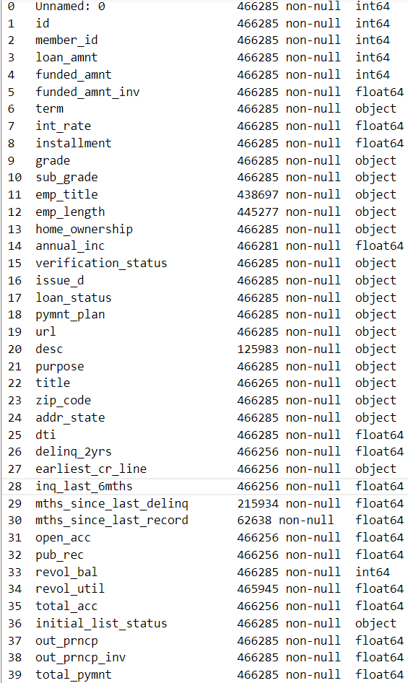
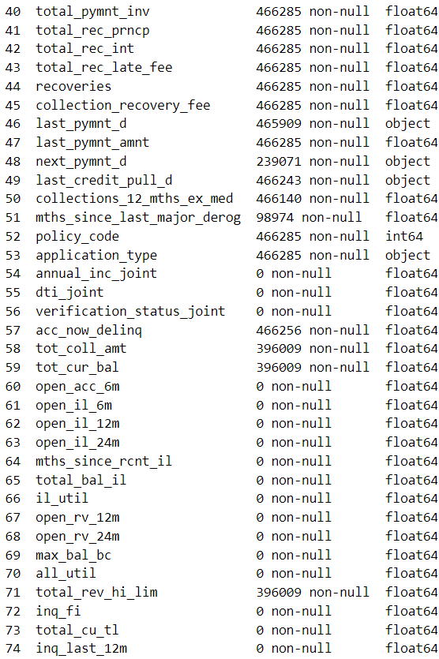
Dataset Overview
X
The dataset comprises a substantial volume of information, with 75 columns and 466k rows.
Within this dataset, 17 features contains null data.
There are nine different labels for loan status in the dataset. We aim to simplify it into two categories: 'Good Loan' represented by '1' and 'Bad Loan' represented by '5’

Slide 5
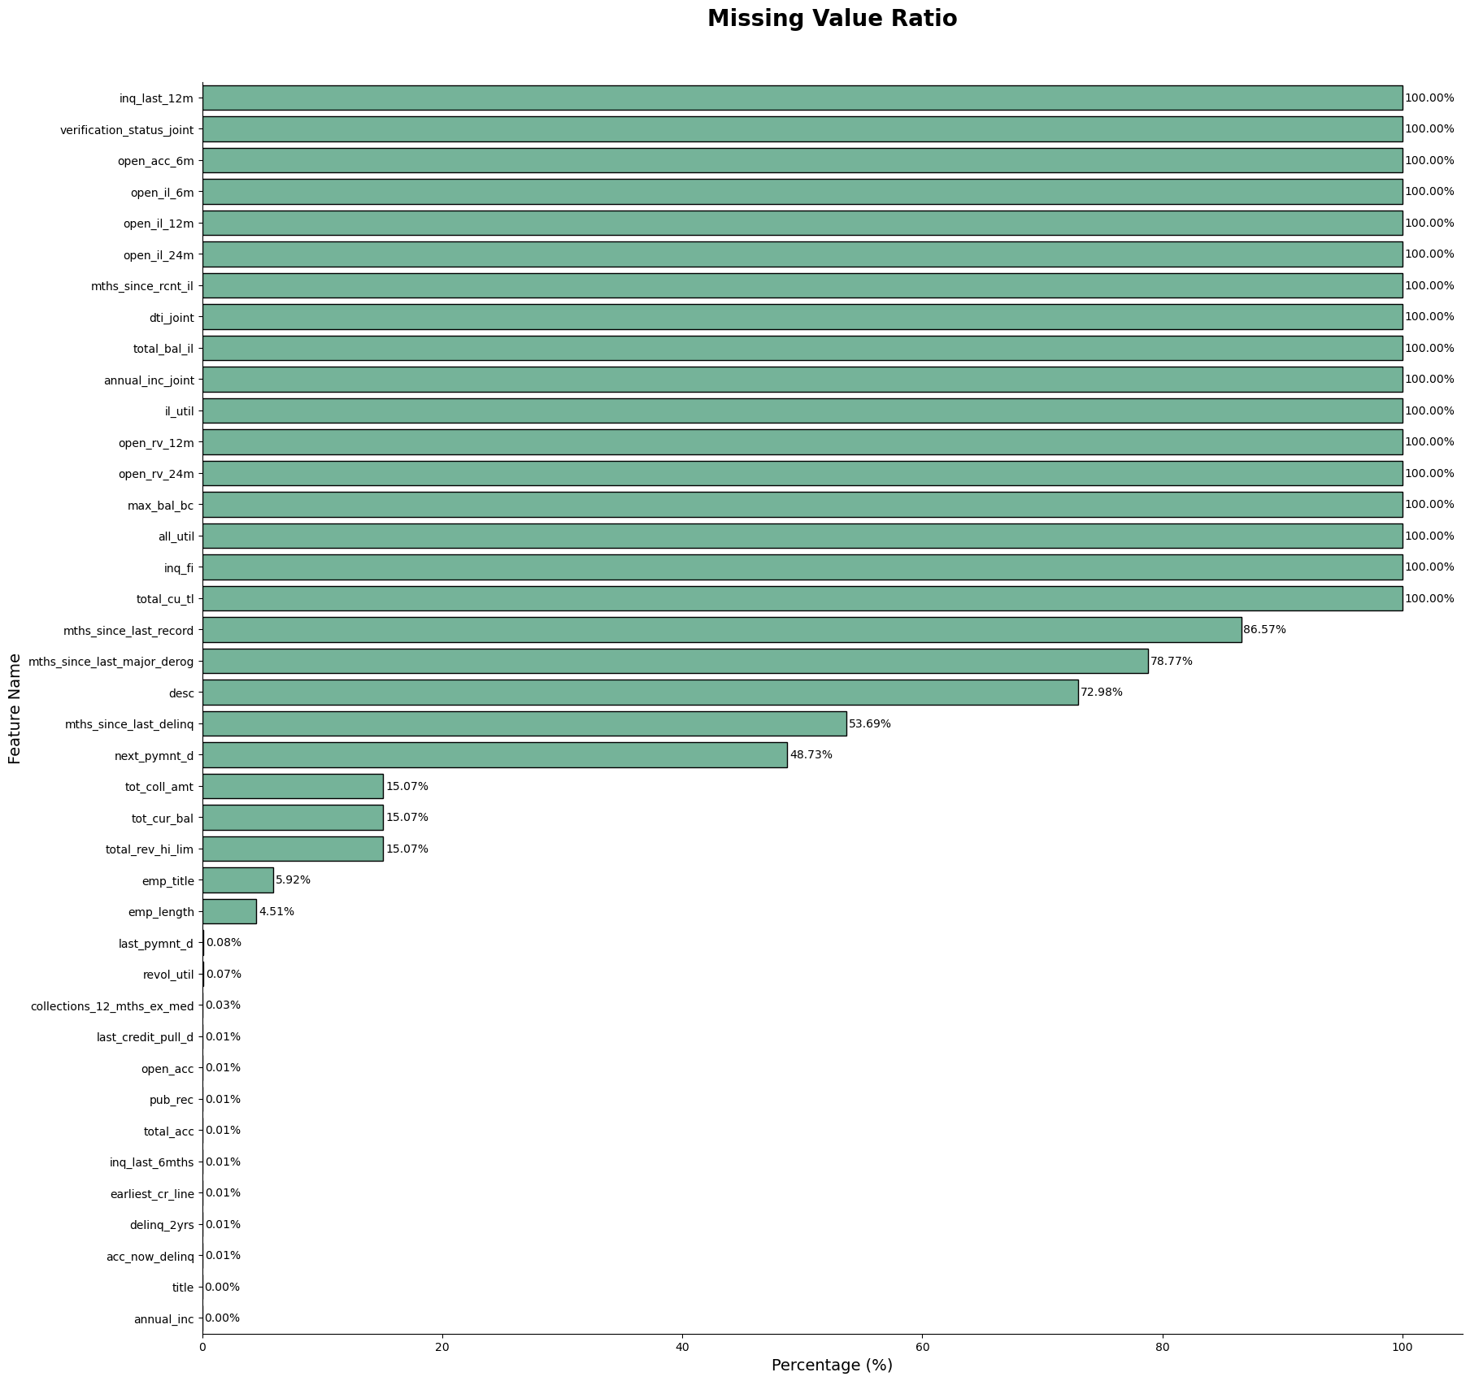
X
Handling Missing Value
There are 17 features that contain 100 missing values, and we will remove these features to prevent bias in our modeling process.
Drop features with more than 50 missing values because they could potentially skew the results when building our models.
For specific features such as 'tot_coll_amt,' 'tot_cur_bal,' and 'total_rev_hi_lim,' we will replace missing values with 0. This decision is based on the assumption that customers didn't borrow a loan in these cases.
Replace numerical features with missing values with the 'Median’.
Replace categorical eature with missing values with the 'Median'.

Slide 6
Data Cleansing
X
Handle The Unnecessary Feature
01
Removing features that contain free text, IDs, or zip codes.
Handle Feature That Contain Only One Unique Value
02
Removing the 'pymnt_plan' feature, as it has only one value throughout the dataset.
Handle Features That Have A High Correlation
Between Independent Features And Target Features
03
There are 7 features with high correlation (>0.8) that had to be removed to improve model accuracy.

Slide 7
Feature Engineering
X
Modifying The Data Type Of Certain Features To Datetime And Add New Features:
01
There are 4 features that will be converted to datetime data type, resulting in two new features:
pymnt_time: Showing the number of months between next_pymnt_d and last_pymnt_d.
credit_pull_year: Indicating the number of years between last_credit_pull_d and earliest_cr_line.
Feature Selection Based On The Weight Of Evidence And Information Value.
02
There are 14 features won't be included in the model due to their low Information Value (<0.02) or suspicious value (>0.5). Additionally, certain features are unsuitable for inclusion, and they will be excluded as well.
Encode All Features For The Model With Label Encoding And One Hot Encoding
03
There are 18 features that set to be encoded for the model. Logistic regression performs optimally with binary values (1 or 0). To accomplish this, numerical features will be categorized into various groups, and one-hot encoding will be applied to each of these feature groups.

Slide 8


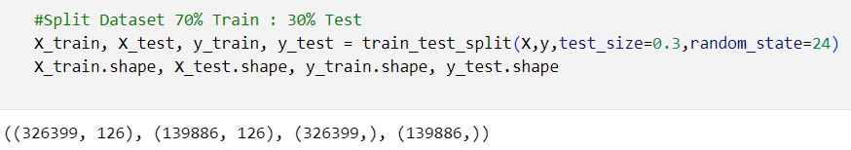
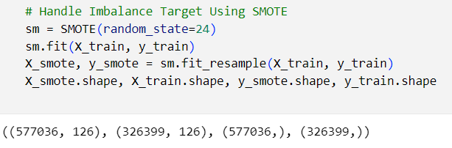
Modelling
Feature Engineering
X
Define Feature Independent (X)
And Target (Y)
Split Data With Ratio 70% Train : 30% Test
Handling Imbalance Target Using Smote

Slide 9
Evaluation Score
X
Algorithm | AUC Score | Accuracy Score
Logistic Regression | 93.50% | 94.92%
Logistic Regression With Hyperparameter Tuning | 93.53% | 94.83%
The AUC SCORE is the critical metric for evaluating this model. Logistic Regression, with hyperparameter tuning, has shown a remarkable 93.53% improvement compared to the non-tuned version. As a result, we've made the decision to employ Logistic Regression with hyperparameter tuning to attain the most accurate predictions.

Slide 10
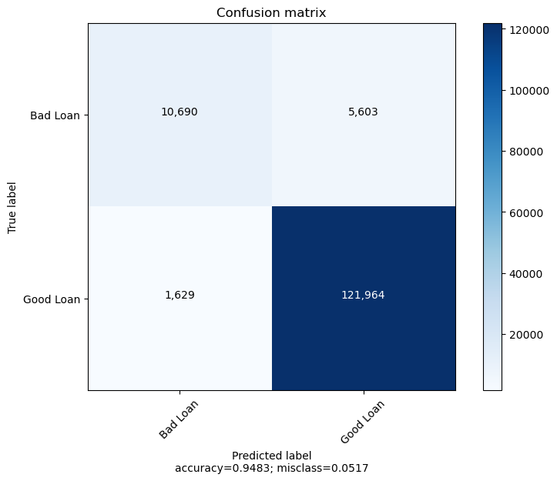
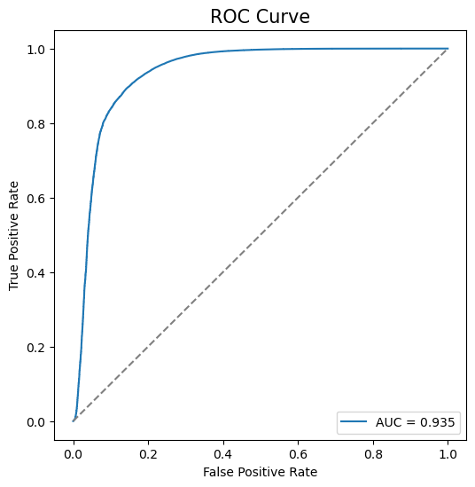
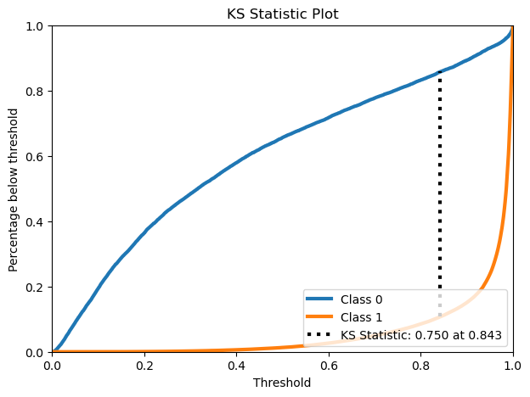
Model Evaluation
X

Slide 11
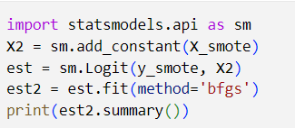
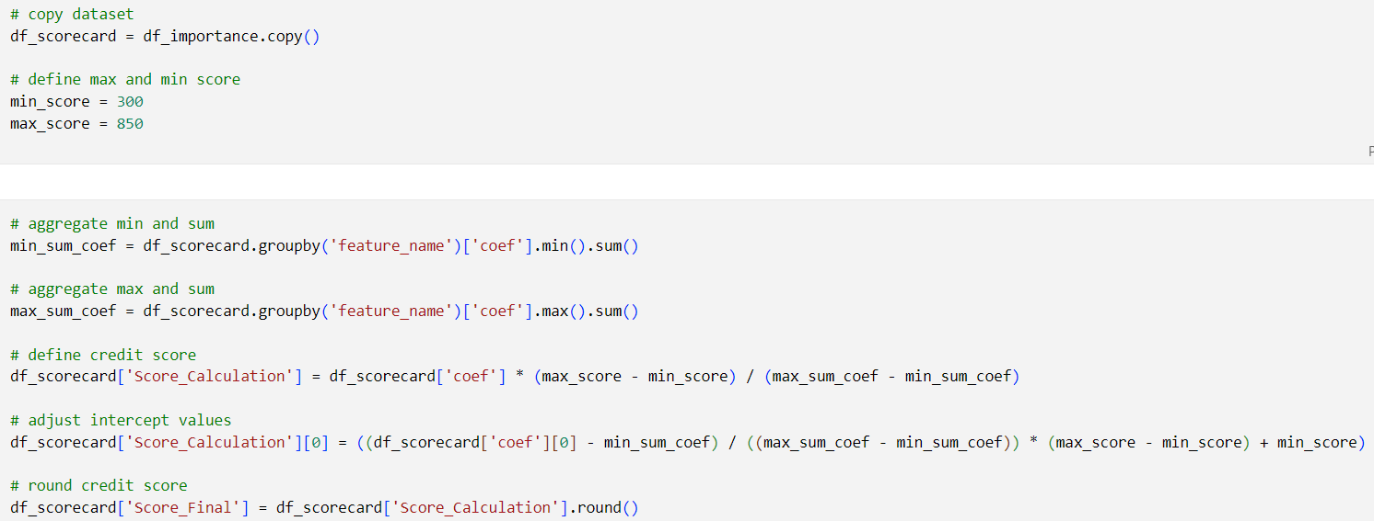
Scorecard
Feature Engineering
X
Get Result From Coefficient Of
Logistic Regression.
Define Min And Max Score Based on FICO Score (300-850).

Slide 12
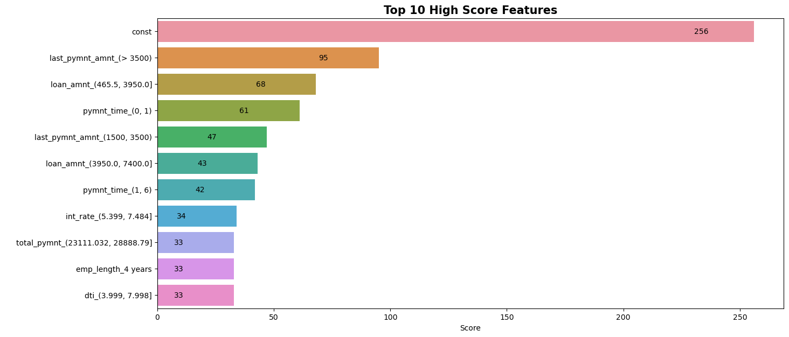
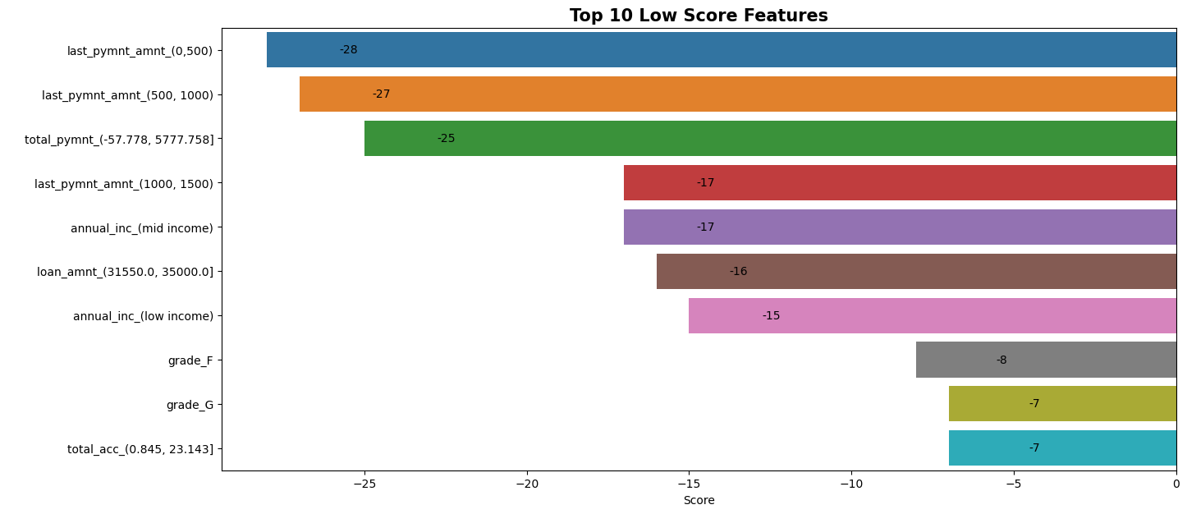
X
Feature Importance
10 features boost credit scores with the highest scorecard.
10 features have the lowest scorecard and lower credit scores.
New customers start with a base credit score of 256 based on our model.

Slide 13
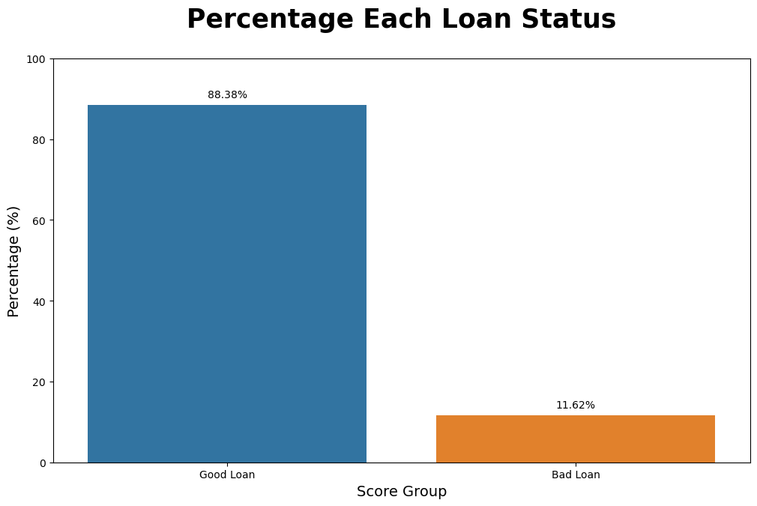
Business Insight
X

Slide 14
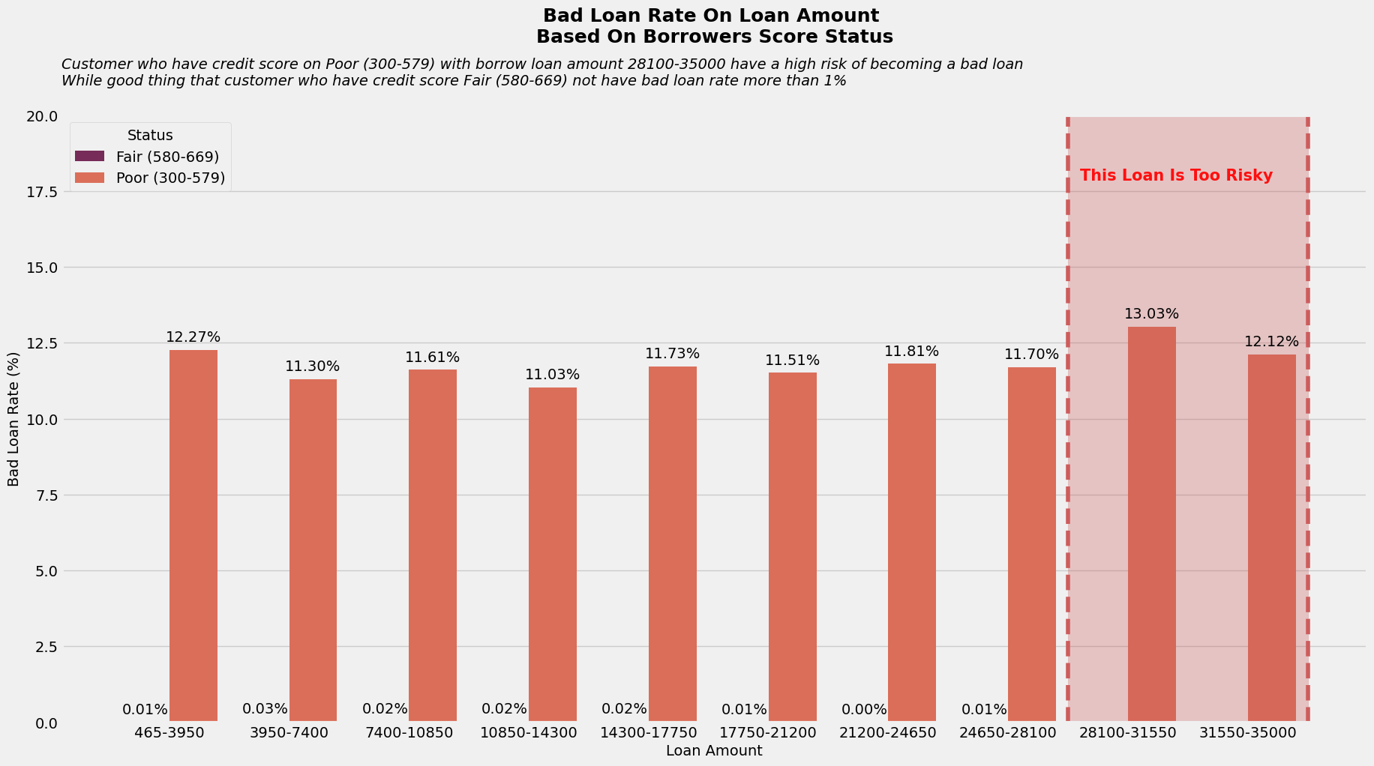
Business Insight
X

Slide 15
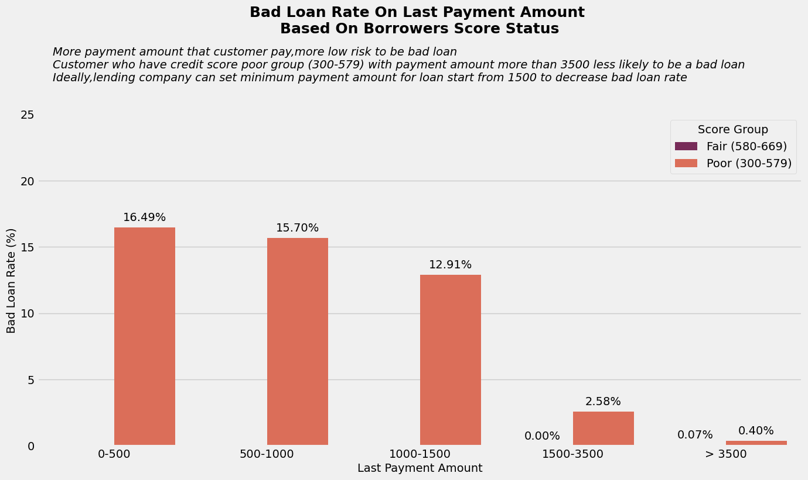
Business Insight
X

Slide 16
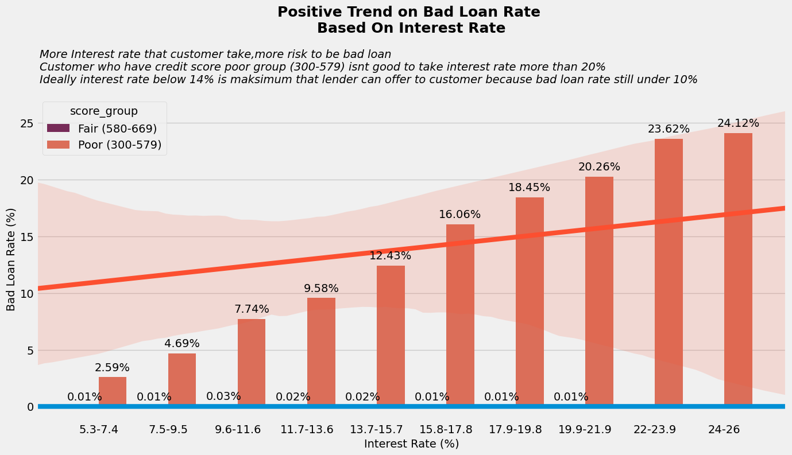
Business Insight
X

Slide 17
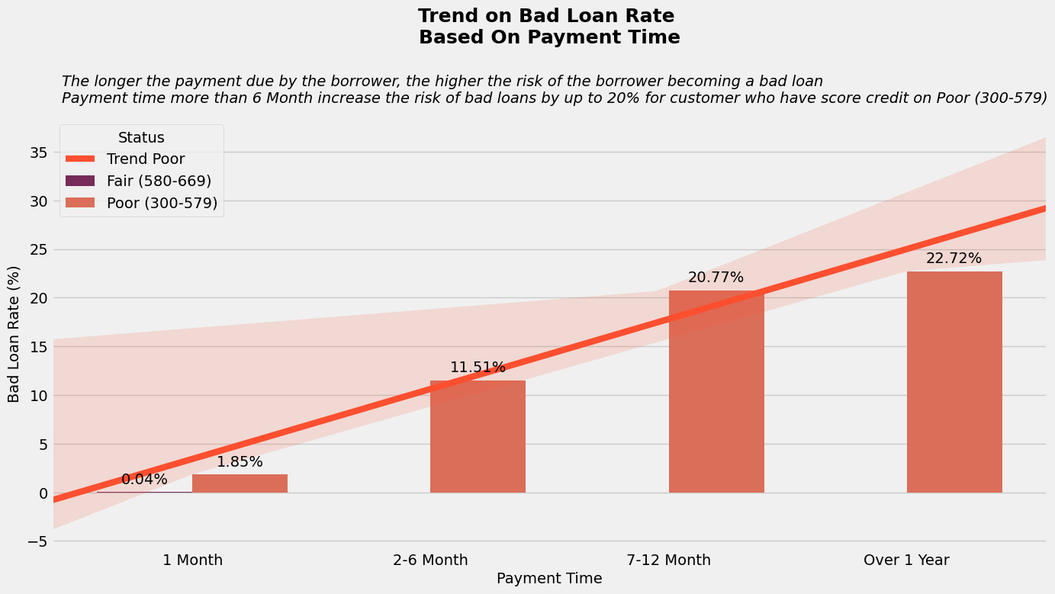
Business Insight
X

Slide 18
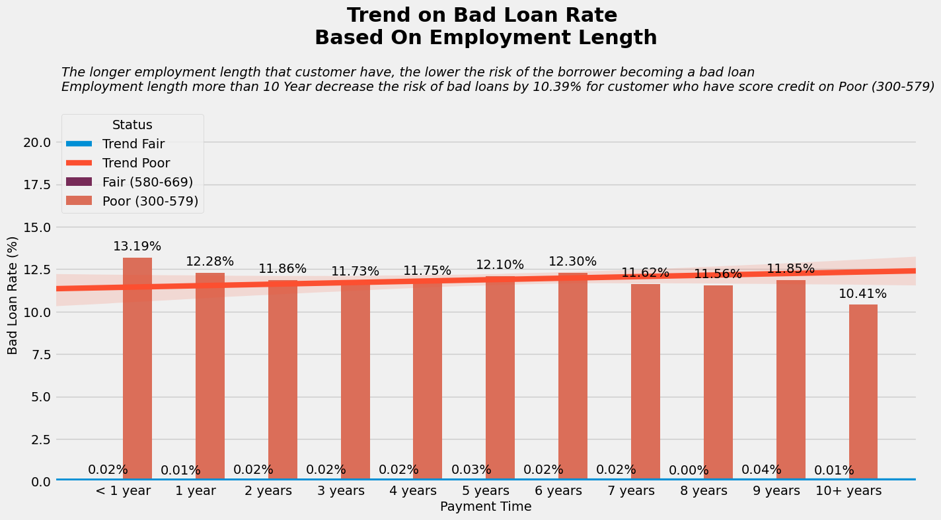
Business Insight
X

Slide 19

Summary
X
Loan Amount
The loan amount plays a critical role in determining the interest rate and overall risk of the loan. Offering large loan amounts is riskier as they often come with higher interest rates. To minimize the risk of a loan becoming bad, it's advisable to avoid recommending loan amounts exceeding 28100.
Last Payment Amount
Customers who make larger last payments are generally less likely to default on their loans. Lending companies can establish a minimum required payment amount, such as 1500, to reduce the risk of bad loans.
Payment Time
The duration over which a customer must repay a loan impacts the risk of it turning bad. To mitigate this risk, companies should limit the maximum payment term to, for example, 6 years, as longer payment times increase the likelihood of defaults.
Interest Rate
Customers who make larger last payments are generally less likely to default on their loans. Lending companies can establish a minimum required payment amount, such as 1500, to reduce the risk of bad loans.
Employment Length
The duration over which a customer must repay a loan impacts the risk of it turning bad. To mitigate this risk, companies should limit the maximum payment term to, for example, 6 years, as longer payment times increase the likelihood of defaults.

